Slide 1
Halberd
Capital Partners
Project Albatross
Aurora Eggs target assessment
Preliminary outside-in CDD for Investment Committee | Pre-LOI screening
Prepared for Halberd Capital Partners | June 2026
Scope of this deck
Target profile, competitive position, consumer context, input-cost exposure, bottom-line levers, by-product economics, alternative-use optionality, prioritized risks and confirmatory DD asks.
Internal - preliminary - no recommendation

Slide 2
EXECUTIVE SUMMARY
Preliminary findings - scaled asset, but transition and retailer-power risks define the underwriting
WHAT SCREENS POSITIVE
WHAT MUST BE PROVEN IN CONFIRMATORY DD
Scale is real
~610k layer hens, FY24 revenue NZ$84.6M and reported EBITDA NZ$10.8M; outside-in triangulation places Aurora at ~18% national volume and #2 behind Mainland.
2027 cage-free deadline is the gating issue
Aurora is still ~40% colony. Expert capex is NZ$11-16M vs sell-side NZ$8-10M; 24-30 months from consent to bird-in-barn leaves limited slack.
Category demand is stable to modestly positive
ACII survey and EPF context indicate +0.6-0.8% per-capita tailwind on top of ~0.9% population growth; eggs benefit from flexitarian, protein and NZ-made narratives.
Retailers and Mainland hold the power
Aurora is a price-taker with no category-captain role, ~50% retail private label and 60-70% of revenue tied to Foodstuffs North/South plus Woolworths NZ.
Value creation is visible at the right entry basis
Feed integration, grading automation and commercial category management could add NZ$3.5-5.5M run-rate EBITDA over 3-4 years; manure offtake adds NZ$0.3-0.5M revenue offset.
Input-cost durability is below the #1 benchmark
No captive feed mill, no captive breeder/DOC, late-2027 electricity re-tariff risk, Huhtamaki packaging concentration, labor pressure and ETS reversibility all warrant explicit downside scenarios.
IC framing
This is not a recommendation. The preliminary evidence says Aurora is interesting only if confirmatory diligence can validate transition timing, customer contract stability and the adjusted EBITDA bridge.
Sources: Aurora IM draft; Aurora website snapshot; Calthorpe transcripts Parts 1-8; Halberd kickoff and internal brief; ACII Wave 11; RetailIQ Q1 2026.
Internal - preliminary outside-in
2

Slide 3
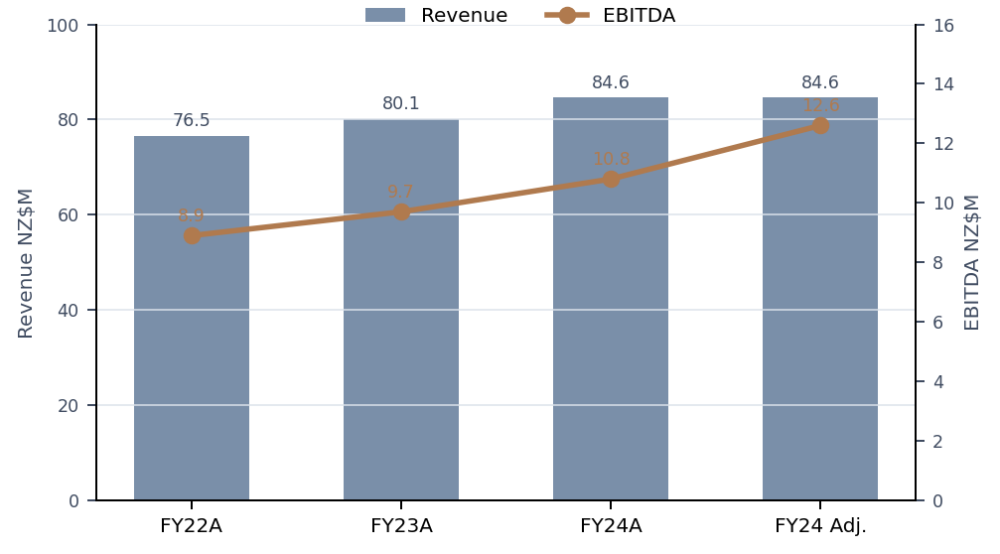
1. ASSET PROFILE
Asset profile - scaled family producer with real earnings and a large colony conversion bridge
FY24 revenue
NZ$84.6M
FY22-24 CAGR ~5.2%
FY24 EBITDA
NZ$10.8M
12.8% reported margin
FY24 Adj. EBITDA
NZ$12.6M
bridge not yet validated
FY24 volume
13.1M dozen
management account basis
Layer flock
~610k hens
#2 by volume, ~18%
Footprint
2 sites
Waikato + Canterbury
OPERATING FOOTPRINT AND MIX
• Production-system mix: ~40% colony, ~30% barn and ~30% free-range, so ~244k colony birds must convert for major-retail shelf access.
• Channel mix triangulates at ~72% retail, ~22% foodservice and ~5% industrial, making the business more retail-heavy than the industry average.
• Aurora owns on-farm grading and packing; it does not own feed milling, breeder/DOC capacity, industrial breaking, or category-captain positions.
• Ownership: McKenna family, third generation. Mark McKenna runs day-to-day as MD; Eleanor McKenna remains family-board chair with chair succession flagged.
Adjusted EBITDA bridge is a diligence item
Sell-side IM presents NZ$12.6M FY24 adjusted EBITDA (14.9% margin) vs reported NZ$10.8M (12.8%). Industry benchmark margins cluster 8-15%, with most producers at 10-12%. Confirm addbacks before using adjusted earnings in any valuation anchor.
Sources: Aurora IM draft v0.4, pages 3-7; Aurora website snapshot; Calthorpe Parts 1, 2, 6; Pacific Agri Advisory sector briefing.
Internal - preliminary outside-in
3

Slide 4
2. COMPETITIVE POSITION ALONG VALUE CHAIN
Aurora is mid-stack - it captures grow-out and grading economics but not upstream hedges or retailer power
Breeder / DOC
External
Northern Hylines / Henergy
Feed milling
External
Farmlands / NRM / Ridley
Grow-out
Owned
2 farms, 610k hens
Grading / packing
Owned
on-farm lines
Brand + PL pack
Mixed
Sunbright + Pams/Macro
Retail / FS channel
Accessed
retailer DCs + wholesalers
Category captaincy
Not owned
Mainland holds role
Aurora owned / controlled stages
External / retailer-controlled stages
PER-DOZEN ECONOMICS AND CONTROL POINTS
Mainland benchmark gap
Mainland operates a seven-stage stack: breeder, DOC, feed, grow-out, grading, brands and category captaincy. Aurora is a four-stage stack, which limits pricing power and input-cost protection.
Tier / channel | Gate price | Producer EBITDA / doz. | Value-chain read
Branded free-range retail | NZ$5.40 | NZ$0.65-0.85 | Highest Aurora tier, but retailer net contribution still ~2.5x producer EBITDA
Branded barn retail | NZ$4.50 | NZ$0.50-0.65 | Core cage-free everyday price tier
Private-label free-range | NZ$4.55-4.85 | NZ$0.30-0.45 | ~12-18% lower gate price; roughly half branded margin
Industrial / seconds | NZ$3.20-3.60 | NZ$0.25-0.40 | Clearance channel for 4-6% off-spec plus bulk/ingredient demand
Retailers capture the largest profit pool
Retail is asset-light relative to producers and captures the largest absolute dollar margin per dozen. Foodstuffs and Woolworths set shelf access, planogram and private-label tender economics.
Commercial implication
Treat Aurora as a price-taker on volume that matters, not a price-setting #2.
Sources: Calthorpe Parts 4, 6 and 7; Halberd value-chain margin annex; Hartley Pearce competitor overview.
Internal - preliminary outside-in
4

Slide 5
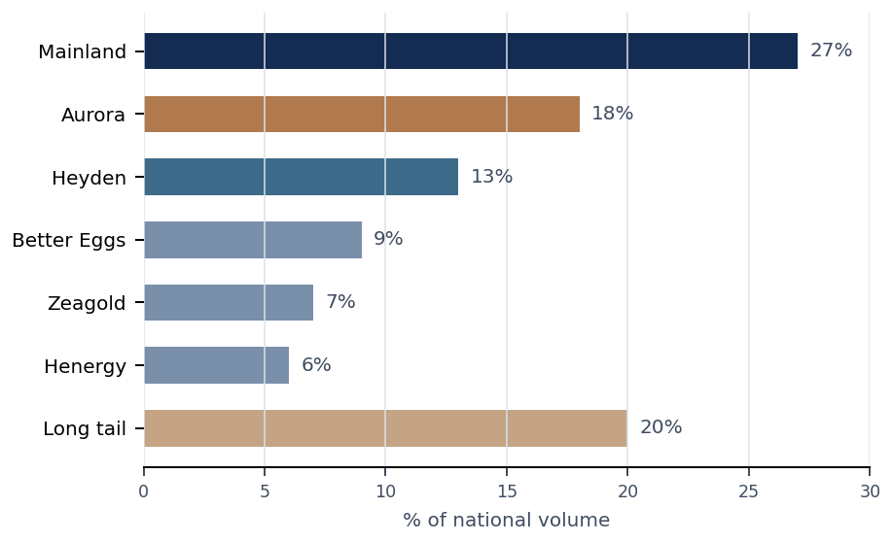
2. COMPETITIVE POSITION VERSUS COHORT
Aurora is #2 by volume, but mid-pack on integration depth, private-label exposure and margin quality
Producer | FY24 rev. NZ$M | Vol. share | Integration depth | EBITDA margin | Brand / PL read
Mainland | 240 | 27% | Full 7-stage | 14-16% | 70 / 30; category captain
Aurora | 84.6 | 18% | 4-stage mid-stack | 12.8% reported | ~50 / 50; most PL-exposed top-five ex-Zeagold
Heyden | 108 | 13% | 4-stage | 11-13% | 55 / 45; South Island concentrated
Better Eggs | 78 | 9% | 4-stage | 10-12% | 60 / 40; deepest specialty bench
Zeagold | 62 | 7% | Forward industrial | 13-15% | 30 / 70; industrial / egg products mix
Henergy | 48 | 6% | 4-stage | 9-11% | 75 / 25; pure-play free-range
Private target treatment
Aurora does not appear in public analyst rosters. Expert triangulation places it at ~18% national volume. It is additive to the known public-tracked roster, not a reallocation from Mainland or other named producers.
Read-through
The volume-share headline is attractive, but Aurora does not carry Mainland-like vertical integration or planogram power. A full-stack precedent multiple should not be imported without a structural discount or a clearly identified operational uplift case.
Sources: Hartley Pearce Agribusiness Research, NZ Shell-Egg Producer Cohort, 28 Mar 2026; Calthorpe Parts 1, 2 and 6.
Internal - preliminary outside-in
5

Slide 6
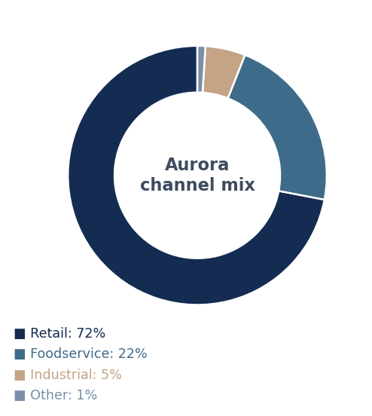
2. CHANNEL AND CUSTOMER POSITION
Retail access gives Aurora relevance, but private label and concentrated accounts compress margin durability
RETAIL CONCENTRATION AND STRUCTURE
Counterparty | Aurora exposure | Structural read
Foodstuffs NI + SI | 40-45% of revenue; 55-60% of retail volume | Two co-ops plus store-owner ranging discretion; better than Woolworths but Pams tenders create cliffs
Woolworths NZ | 20-25% of revenue; 35-40% of retail volume | Single national buyer; one decision delists nationally; 3-5 pp more margin pressure per expert
Costco / independents | 5-10% of retail volume | Residual, not thesis-defining
PRIVATE-LABEL EXPOSURE
• Blended retail private-label share is estimated at ~50%; barn PL exposure likely 55-65%.
• PL gate prices are ~12-18% below branded for equivalent product spec; PL EBITDA per dozen can be roughly half branded.
• Two Aurora private-label lines reportedly come up for retender inside 24 months; loss of one Pams free-range tender could be a NZ$8-12M revenue cliff.
• Foodstuffs website update shows a supply agreement extension to 2030, but the actual volume, price, termination and cage-free clauses are unknown.
Channel economics
Foodservice gate price is ~3-4% below retail and runs through Bidfood / Gilmours with 12-18% distributor margin. Industrial is a residual clearance channel for seconds and carries the thinnest producer EBITDA per dozen.
Confirmatory ask
Request audited revenue by legal customer, banner, production system, channel, brand vs private label, contract expiry, notice period, price-review mechanism and trade spend.
Sources: Calthorpe Parts 2 and 4; Aurora website news dated 12 Mar 2026; RetailIQ Q1 2026 notes; Halberd value-chain annex.
Internal - preliminary outside-in
6

Slide 7
3. COMPARABLE BENCHMARKING
Comparable guardrails - seller ask requires a premium to a fuller-stack NZ precedent
Anchor | Headline multiple | Adjustment required | Preliminary read for Aurora
Cal-Maine Foods | 9-11x mid-cycle EBITDA | >50x Aurora scale; US listed liquidity; recent US HPAI cycle; pure-play but different geography. Apply 35-45% scale haircut plus 20-25% private discount. | Illustrative public-comp chain lands ~4-6x before risk-specific adjustments. Useful as ceiling / context, not primary anchor.
Inghams Group | 8-9x EBITDA | AU/NZ broiler, not layer; product mix and working-capital cycle differ. Apply product-mix and scale haircut. | Adjacency only. Do not import broiler economics into layer underwriting.
PEP - Mainland 2025 | 7.0-7.5x EBITDA | Most direct in-NZ platform precedent, but Mainland is full-stack #1 with feed, breeder, brands and category captaincy. | Aurora lacks the full stack and has higher colony / PL exposure, so a premium to Mainland requires clear transition proof and buyer-owned uplift.
Navis - Mainland 2017 | ~6.5x EBITDA | Prior-cycle platform precedent, same sector. | Supports mid-single to high-single digit direct-sector anchor.
Better Eggs / Smith 2023 | 5-6x EBITDA | Sub-scale specialty tuck-in. | Relevant for roll-up optionality and specialty cohort pricing.
Seller ask | 12-14x FY24 Adj. EBITDA | Uses unvalidated NZ$12.6M adjusted EBITDA; assumes clean 2027 conversion and durable 30%+ free-range premium. | Negotiation gap is visible versus adjusted public comps and direct NZ precedents.
Valuation guardrail, not recommendation
Internal screening and expert interviews point to 8-10x reported FY24 EBITDA as the practical pre-LOI guardrail if the colony-risk haircut is retained; Calthorpe upper case with visible cost-out was NZ$100-115M EV. IC should treat this as a diligence anchor, not a bid recommendation.
Sources: Hartley Pearce competitor overview; Calthorpe Parts 3 and 6; Halberd analytical standards; Aurora IM draft; Cal-Maine 10-K / public deal context.
Internal - preliminary outside-in
7

Slide 8
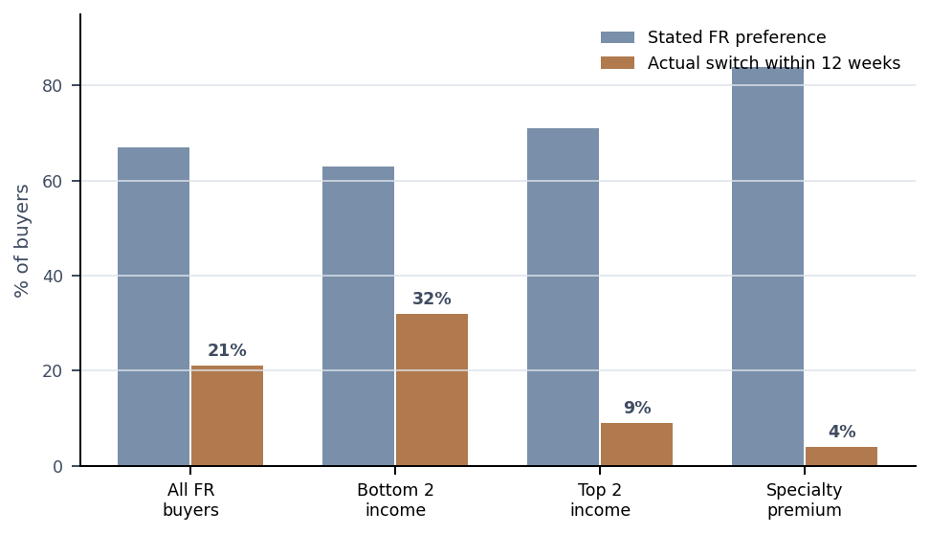
4. CONSUMER-DEMAND CONTEXT
Consumer context - egg category tailwind does not protect the commodity free-range premium
CATEGORY-LEVEL DEMAND SUPPORTS
• Dietary mix is a net tailwind: flexitarians are 21.4% of adults and consume 242 eggs/adult/year vs 224 for traditional omnivores; vegetarians consume 263.
• Demographic-cuisine mix adds support: Asian-NZ cohort consumes 268 eggs/year, +17% vs national average, and is projected to rise from ~17% to ~22-24% of adults by 2038.
• Purchase drivers have shifted toward category tailwinds: NZ-made moved from rank 5 to 2, high-protein from rank 8 to 3, and heart-health from rank 11 to 8.
Forecast implication
Net per-capita drift of +0.6-0.8% pa on top of NZ population growth is defensible, but not a 5-7% annual Aurora volume growth proof point by itself.
RISK TO AURORA-SPECIFIC MIX
• ACII shows 67% stated free-range preference, but 21% of free-range buyers actually switch within 12 weeks of a NZ$30/week budget tightening.
• RetailIQ elasticity: commodity free-range is elastic at -1.34, while pasture-raised premium is less elastic at -0.56.
• Plant-based egg substitute share is <1% today, but FY28-30 displacement sensitivity is 1.5-2.5% if major retailers range chilled plant-based SKUs.
Aurora read-through
Aurora is long commodity free-range and under-indexed in durable specialty tiers. Website references a pasture-raised line for 2027, while expert sources describe no meaningful current pasture-raised or omega-3 SKU. Confirm current SKU economics and launch pathway.
Sources: ACII Wave 11 Egg Addendum; Calthorpe Part 5; RetailIQ Q1 2026 scan data; Aurora website snapshot.
Internal - preliminary outside-in
8

Slide 9
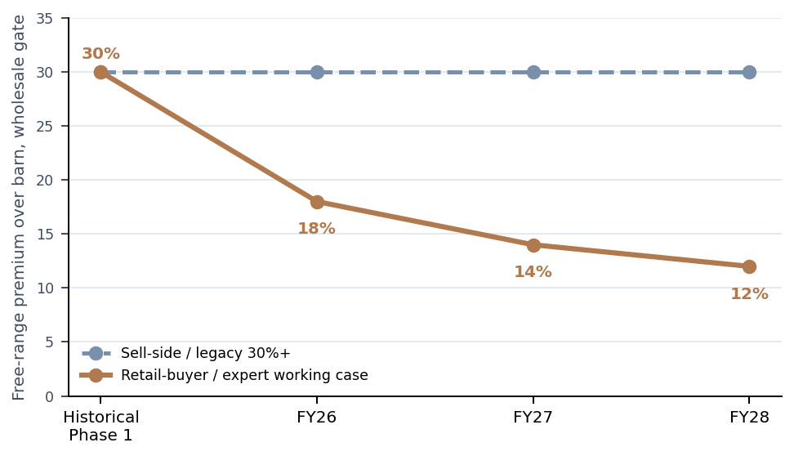
4. CONSUMER AND RETAILER TRANSITION DYNAMICS
Phase 2 is both a share-capture opportunity and a hard shelf-access cliff
RETAILER-DRIVEN DEADLINE
End-2022
Battery cages banned; colony remains legal
2023
Foodstuffs + Woolworths cage-free shelf pledges
FY26
Aurora still ~40% colony, ~244k birds
End-2027
Major retail packaged shell eggs cage-free
1 Jan 2028
Colony range-loss risk if conversion slips
AURORA CONVERSION MATH
Why the premium compresses
The 2027 cage-free pledge drives colony capacity into barn because barn satisfies retailer policy at roughly one-third of free-range capex. As barn supply scales, free-range loses scarcity. Retail scan data already shows only ~16-18% shelf premium for one-dozen free-range vs barn in Q1 2026.
• Colony cohort: ~40% of 610k birds = ~244k birds, equivalent to ~70M eggs annualized.
• Sell-side capex: NZ$8-10M. Expert / sector range: NZ$45-65 per bird, or NZ$11-16M for Aurora.
• End-to-end timeline: 4-12 months consents, 14-18 months build, 6-9 months DOC lead time; equipment lead time 9-14 months.
• If colony volume is stranded for 12 months, expert rough math is ~NZ$14M revenue hit and ~NZ$3-4M EBITDA hit.
Confirmatory threshold
Evidence of consents, equipment order slots and DOC / pullet orders is deal-defining.
Sources: Retailer cage-free commitments summary; EPFNZ transcript; Calthorpe Parts 2 and 3; RetailIQ Q1 2026; Aurora IM draft.
Internal - preliminary outside-in
9

Slide 10
5. TOP-LINE OPPORTUNITIES
Top-line opportunities - highest-quality levers require specialty mix and branded share
Lever | Evidence / rationale | Preliminary outside-in size | Confirmatory work
Specialty premium tier extension | ACII WTP vs barn: pasture +62%, omega-3 +44%, organic +78%; specialty actual switch only 4%. Aurora lacks meaningful current pasture / omega-3 SKU. | If 5-8% of volume migrates to specialty with NZ$0.50-0.80/doz incremental EBITDA: ~NZ$0.3-0.8M annual EBITDA. SKU launch capex and retailer authorization not sized. | Validate current SKU map, retailer interest, range-area constraints, capex and production yield.
Branded mix uplift vs private label | PL gate prices 12-18% below branded and EBITDA/doz can be roughly half branded; Aurora retail volume ~50% PL. | 5-10 pp shift of retail volume from PL to branded at NZ$0.25-0.40/doz incremental EBITDA: ~NZ$0.1-0.4M annual EBITDA. | Get brand / PL P&L by retailer and tender calendar; test feasibility given Mainland category-captain role.
Share from long-tail exits | Phase 2 capex likely forces 6-10 long-tail operators to exit or sell by FY28; Aurora can win if its conversion is on time. | 1-2 pp national volume share capture at ~0.9M dozen per pp and NZ$0.30-0.50 EBITDA/doz: ~NZ$0.3-0.9M annual EBITDA before required capacity. | Confirm spare cage-free capacity, retailer allocation, incremental capex and working capital.
Specialty / pasture roll-up | 5-8 named specialty operators, 150-200k birds combined; typical 5-6x EBITDA, NZ$3-8M each; total NZ$30-50M programme. | Inorganic optionality, not base case. Synergies per Hartley Pearce framework: procurement 4-6% of opex; footprint 5-12% where geography supports. | Screen named targets, ownership willingness, animal-welfare credentials and integration risk.
Sources: ACII Wave 11 Addendum; Calthorpe Parts 3, 5 and 6; Hartley Pearce competitor overview; RetailIQ Q1 2026.
Internal - preliminary outside-in
10

Slide 11
6. BOTTOM-LINE OPPORTUNITIES
Bottom-line opportunities - largest levers address the Mainland gap
Lever | Current gap | Capex / investment | Run-rate EBITDA / cash impact | Payback / diligence
Captive feed mill | Aurora buys compound feed externally; feed is 55-65% of variable cost and Mainland has MainFeeds as a physical hedge. | NZ$8-12M modest scale mill | ~NZ$1.5M annual savings | 5-7 yrs; confirm grain sourcing, site, permits and volume threshold.
Grading + packing automation | Two plants run mid-generation grading lines with manual candling / defect detection; Zeagold has vision-graded automated line. | NZ$8-12M combined, or NZ$4-6M per plant | NZ$1-2M annual opex savings; 30-40% labor reduction on grading; 1-2 pp retail-grade improvement | 5-7 yrs; confirm current OEE, defect rate and integration downtime.
Commercial category management | No category-captain status, no institutional-quality retail analytics; Mainland shapes planograms. | Low to modest: commercial GM, trade analytics, category management tools | NZ$1-2M annual margin contribution if 1-2 pts share-of-shelf / price realization captured | Harder to underwrite; confirm retailer relationships and trade-spend baseline.
Manure offtake discipline | By-product revenue offset often missed; not a standalone upside if already in accounts. | Low incremental capex if stockpile / logistics already adequate | NZ$0.3-0.5M annual revenue offset from 18-22k tonnes at NZ$15-25/t | Confirm contracts with Ravensdown / Ballance and accounting treatment.
Platform procurement / WC | Retail DSO 60-90 days vs feed suppliers 30 days; retail WC gap ~30 days of revenue. | Process / systems and supplier negotiation | Working-capital release and procurement benefit unquantified outside-in | Request AR/AP aging, inventory turns, supplier terms and bank facilities.
Preliminary outside-in total: feed mill + automation + commercial category management can add NZ$3.5-5.5M run-rate EBITDA over 3-4 years on NZ$16-24M capex before working-capital effects. This is value-creation work, not a seller-proven run-rate.
Sources: Calthorpe Parts 2, 3 and 7; Henry Calder operator interview; Halberd supplier exposure and alt-use annexes; Hartley Pearce synergy framework.
Internal - preliminary outside-in
11

Slide 12
7. INPUT-SIDE COST AND RISK EXPOSURE
Input-side exposure - one tier down versus Mainland on cost volatility
Exposure | P&L / risk weight | Aurora position | Impact / DD focus
Feed grain | 55-65% of variable cost; feed cost ~NZ$1.85-2.10/doz | External feed; 4-6 weeks inventory; no formal futures hedge. Mainland has captive MainFeeds and 8-10 weeks physical inventory. | 10% spot grain spike can compress gross margin 80-110 bps for 1-2 quarters. Get feed contracts, price reviews and inventory.
Electricity | 8-10% variable cost blended | 2024 large-commercial tariff locks pre-2025 spike until late 2027; re-tariffs just as barn footprint ramps. | +18-22% electricity line from FY28 could hit colony / barn margins by 150-220 bps. Request contracts and load forecast.
DOC / pullets | Operational gating item | No captive breeder. Buys point-of-lay pullets through Northern Hylines / spot AU routes; supply tightens during conversion waves. | 4-5 month normal wait, 6-9 months in tight market. 2-quarter delay risk. Need placed orders and contingency.
Conversion equipment | Capex gating item | Industry chatter: Big Dutchman signed in late 2025; European vendor pipeline limited, 9-14 month lead time. | No slack to end-2027 if order / commissioning slips. Request signed PO, milestones and liquidated damages.
Packaging | 4-6% of retail variable cost | Huhtamaki Otahuhu is the only large-scale NZ moulded-fibre egg-carton supplier; AU import lead time 4-6 weeks. | Common-mode risk: 2-3 week domestic disruption can hit all producers. Ask safety-stock and backup packaging.
Labor and automation | 18-22% variable cost; 110-130 staff | Skilled stockmen and grading operators scarce; AEWV wage thresholds pressure migrant labor. Aurora lags Zeagold automation. | Wage inflation plus transition complexity. Validate headcount, wage bands, retention and automation plan.
ETS / biosecurity | Scenario risk | Agriculture currently outside ETS, but policy reversible. H7N6 biosecurity event costs are material per affected farm. | ETS re-inclusion could cost NZ$0.5-1.5M pa; H7N6 cleanout can be 25-35% EBITDA hit per affected farm. Review insurance / protocols.
Sources: Calthorpe Part 7; Halberd supplier exposure annex; USDA FAS grain notes; MBIE / Stats NZ electricity anchors; WOAH H7N6 self-declaration.
Internal - preliminary outside-in
12

Slide 13
8. BY-PRODUCTS, OFFSETS AND ALTERNATIVE-USE OPTIONALITY
By-product economics are useful offsets; alternative-use land optionality should not be underwritten without a named buyer
Egg grading economics
Grade A retail eggs are ~65-75% of volume and the main money. Grade B / cracked / liquid is ~25-30%, flows to breakers / industrial at lower margin. Spoilage is ~1-5%. Automation can move 1-2 pp into retail-grade product.
Manure revenue offset
Aurora’s 610k flock implies ~18,000-22,000 tonnes of manure per year. Ravensdown / Ballance buy poultry manure as Class A organic input at NZ$15-25/t, implying NZ$300-500k annual revenue offset.
Spent-hen economics
Spent hens route to pet-food ingredient, rendering or small live export markets. Operator evidence indicates NZ$0.40-1.20 per bird in good years, sometimes nil; disposal is closer to a cost than a hidden value lever.
Industrial / breaker optionality
Aurora has no industrial egg-products division. Industrial demand clears seconds and off-spec volume, but producer EBITDA per dozen is the thinnest. Cal-Maine’s M&A pattern suggests egg-products adjacency is valuable only with real processing capability.
Alternative-use optionality - treat as an open DD question, not a valuation premium
Sell-side has floated data-centre, solar and dairy / agricultural conversion optionality. Calthorpe and Calder directly contradict realizability on Aurora’s specific sites: both sites are rural-production zoned and HPL-overlay soils; both sit outside the north-west Auckland data-centre cluster; utility solar tends to be a lease at agricultural value, not a buy-out; any non-rural use has 24-36 month consenting risk plus appeals. Confirm whether a named non-egg buyer exists and at what premium to rural-production going-concern.
Sources: Henry Calder operator interview; Calthorpe Parts 7 and 8; Halberd business model / alt-use annex; Tasman Mercantile follow-up excerpt.
Internal - preliminary outside-in
13

Slide 14
9. RISKS
Prioritized risk register - five risks that matter for pre-LOI underwriting
Risk | Evidence | Impact | Probability | Mitigant / confirmatory ask
1. Colony-to-barn transition slip | 40% colony; no public Selwyn / Waikato RMA lodgement found by expert; 24-30 month end-to-end timeline vs end-2027 pledge. | High | Med / unknown | Demand consents, pre-lodgement records, Gantt, Big Dutchman PO, DOC / pullet orders and contingency capacity.
2. Retail concentration + PL tender cliff | Top 3 legal retail accounts likely 60-70% revenue; PL ~50% retail volume; one Pams FR tender loss = NZ$8-12M revenue cliff. | High | Med | Audited top-10 customer / banner / SKU revenue, contract expiries, tender calendar, cage-free clauses and trade-spend roll-up.
3. Free-range premium compression | Broker 30%+ conflicts with 2026 transaction prices and RetailIQ shelf data; expert trajectory 18% FY26 -> 14% FY27 -> 12% FY28. | Med / High | High | Request actual gate prices by SKU, price review clauses, elasticity history and consumer / retailer category research.
4. Input-cost and supplier exposure | No captive feed or breeder; 2027 electricity re-tariff; Huhtamaki packaging sole supplier; DOC and equipment lead-time bottlenecks. | Med / High | Med | Supplier contracts, inventory, tariff terms, packaging backup, labor plan, insurance and ETS scenario.
5. Governance, key people and site concentration | Family board chair succession; Mark and Hone key-person reliance; only one site per island; H7N6 event can be 25-35% EBITDA hit per affected farm. | Med | Med | Board decision rights, chair transition plan, management retention, site-level BI / biosecurity insurance and disaster recovery.
Sources: Calthorpe Parts 2, 3, 4, 6, 7 and 8; ACII Wave 11; RetailIQ Q1 2026; WOAH self-declaration; Aurora IM / website.
Internal - preliminary outside-in
14

Slide 15
10. CONFIRMATORY DILIGENCE
Confirmatory DD priorities - specific data requests that move the underwriting
1. Conversion proof
• RMA and building consent filings plus pre-lodgement correspondence
• Project Gantt with critical path, contractor scope and contingency
• Equipment PO / delivery milestones and DOC / pullet order book
2. Customer and contract durability
• Audited revenue by customer, banner, channel, SKU and production system
• Branded vs private-label P&L by retailer
• Contract expiry, notice, price-review, cage-free clauses and tender calendar
3. Unit economics and quality of earnings
• FY22-24 audited financials and adjusted EBITDA bridge
• Per-dozen margin by channel, SKU and production system
• Trade-spend, grade yield, seconds, manure and spent-hen accounting
4. Input-side resilience
• Feed contracts, inventory policy and pass-through mechanics
• Electricity tariff expiry and load forecast through conversion
• Packaging backup, labor plan, insurance, ETS and biosecurity protocols
5. Governance and asset optionality
• Board seats, veto rights, chair succession and external NED renewal
• Mark / Hone retention and succession plans
• Land titles, HPL overlays, zoning and any named non-egg buyer interest
IC read-across
The diligence path is narrow: a buyer can spend confirmatory resources efficiently if the first data drop proves conversion timing and commercial contract durability. If those two are weak, the remaining diligence work will mostly quantify downside rather than surface new upside.
Sources: Halberd IC pre-read template; Vivian Holst must-test email; Calthorpe Parts 3, 4, 6, 7 and 8; Calder interview.
Internal - preliminary outside-in
15

Slide 16
11. SYNTHESIS
Key findings synthesis - what the preliminary work says and what remains unresolved
Finding | Direction | What preliminary evidence supports | What remains unresolved
1. Scale / position | + / - | Aurora likely is the #2 volume producer at ~18% share and has two-island retail access. | It is only a 4-stage mid-stack producer and lacks Mainland’s integration and category-captain economics.
2. Demand context | + / - | Egg category demand has modest structural tailwinds from flexitarian, demographic, protein and NZ-made drivers. | Commodity free-range premium is compressing and Aurora is under-indexed to specialty premium.
3. Transition execution | - / ? | 40% colony exposure must convert before retailer shelf-access deadline; expert capex/timeline exceeds sell-side framing. | Actual consent status, equipment slot and pullet order book are not yet verified.
4. Earnings durability | - / + | Input-cost pass-through lags, PL mix and customer concentration pressure current EBITDA durability. | Feed mill, automation and commercial category management could offset pressure if funded and executed.
5. Optionality | + / - | Fragmented long tail and specialty cohort create roll-up / mix-shift options; manure offset is real. | Alternative-use land-bank premium is unproven and should not be underwritten absent a named buyer.
Pre-LOI conclusion for IC framing
Aurora is a credible asset with tangible operational value-creation levers, but the preliminary evidence does not support underwriting the seller’s clean-transition / durable-premium narrative without confirmatory proof. The IC decision should hinge on whether the team is prepared to test conversion proof and customer-contract durability first.
Sources: Full source pool summarized across deck. No recommendation is made at pre-LOI stage.
Internal - preliminary outside-in
16

Slide 17
APPENDIX
Source index and key caveats
PRIMARY SOURCES USED
CAVEATS AND CONTESTED POINTS
• Aurora materials: draft preliminary IM v0.4, public website snapshot and broker outreach / follow-up materials.
• Expert interviews: Robert Calthorpe Parts 1-8; Henry Calder operator interview; EPFNZ interview; foodservice broker transcript used for channel context only.
• Industry and market data: Hartley Pearce competitor overview, RetailIQ Q1 2026 retail scan data, ACII Wave 11 Egg Category Addendum, NZ supermarket cage-free commitment summary, WOAH / MPI H7N6 self-declaration.
• Halberd internal materials: kickoff email, Vivian Holst must-test email, internal screening brief, value-chain margin annex, consumer-demand annex, supplier-exposure annex and business model / alt-use annex.
• Analytical standards: Halberd brand guidelines, analytical standards guide and pre-LOI IC pre-read template.
• Aurora is privately held; producer-specific figures are triangulated unless directly cited from the sell-side IM or website. Confirm audited numbers in data room.
• FY24 adjusted EBITDA of NZ$12.6M is unvalidated; use reported NZ$10.8M until addback schedule is reviewed.
• Production-system mix and private-label exposure are expert-triangulated and must be confirmed by management records.
• No public RMA consent was found by the industry expert, but pre-lodgement or non-public processes may exist; confirm directly.
• Opportunity sizing is outside-in and indicative. It is meant to guide diligence prioritization, not serve as a bid model or IC recommendation.
Compiled by Halberd deal team from source pool. Figures rounded; all currency in NZD unless otherwise stated.
Internal - preliminary outside-in
17

