Slide 1
Halberd Capital Partners
PROJECT ALBATROSS
Aurora Eggs Ltd
Preliminary Target Assessment
New Zealand shell-egg producer - trans-Pacific tuck-in screen for the North American agri platform
Outside-in commercial due diligence | Pre-LOI / indicative-bid preparation stage
Prepared for the Investment Committee pre-read. Findings, risks and open questions only - no recommendation. The IC decides whether to advance to confirmatory diligence.
Deal team: V. Holst (Sector Partner) - D. Reyes (Principal) - M. Okonkwo (Sr Assoc) - T. Lindgren (Assoc) - I. Beaumont (Research)
Date: 8 May 2026 Classification: strictly private & confidential - internal

Slide 2
HOW TO READ THIS DECK
Scope, method & evidence base
▪ Stage. Pre-LOI / indicative-bid prep. No CIM, data room or audited financials yet. Working from sell-side outreach, a draft IM, public material, expert transcripts, and public industry sources.
▪ Sources used. Anchor Bay IM draft v0.4 (28 Feb 2026); Tasman Mercantile outreach (20 & 22 Apr 2026; land-bank note 28 May 2026); Aurora website; Halberd internal brief (4 May 2026); Hartley Pearce hp-agri-nz-027; RetailIQ NZ scan Q1 2026; Cal-Maine 10-K FY25; Calthorpe Parts 1-8, Calder, Marsden (EPF), foodservice broker.
▪ Discipline. Findings, risks and open questions only. No recommendation. Per the IC pre-read template hard rules, a pre-LOI deck taking a proceed / pass / bid position is rejected.
▪ Private-target treatment. Aurora is privately held and absent from public analyst coverage. It is added additively to the public producer roster (Hartley Pearce excludes it); public producers' shares are not shrunk to fit Aurora in.
▪ Divergence surfaced. Where the sell-side framing and the independent expert / trade-association / scan-data read diverge, both are shown and the gap is named. Weighting is stated, not hidden.
▪ Vintage. The MPI 33/33/34 production-mix figure is 2022; Phase 2 (retailer end-2027 cage-free pledge) has since shifted the mix. Current-era reads are weighted over the 2022 baseline.
▪ Conventions. NZD figures as stated; USD conversions use Halberd central assumptions (FY24 NZD 0.602). Regional WACC NZ 10.5%. Currency, date and figure conventions per Halberd brand & analytical standards.
▪ Excluded. The intern initial-research pack (J. Park) was reviewed and dropped - multiple claims contradicted primary sources (revenue, ranking, cage exposure, comp set). Not used in this deck.
Project Albatross | Aurora Eggs - Preliminary Target Assessment
Halberd Capital Partners - Internal / Pre-LOI
Strictly private & confidential | 2

Slide 3
PRELIMINARY VIEW
Aurora at a glance
KEY FACTS (FY24, as reported)
THREE HEADLINE READS
▪ Position. #2 NZ producer by volume, ~18% share (behind Mainland 27%); ~610k hens; 2 sites (Waikato NI + Canterbury SI).
▪ Financials. NZD 84.6m revenue; NZD 10.8m EBITDA (12.8% margin). IM “adjusted” NZD 12.6m (14.9%) = NZD 1.8m normalisation to validate.
▪ Mix. ~40% colony / 30% barn / 30% free-range. Channel ~70% retail / 25% foodservice / 5% industrial.
▪ Customers. Foodstuffs 55-60% of retail, Woolworths NZ 35-40%; ~50% blended private-label. Insider read: top-3 retailers ~70% of revenue.
▪ Ownership. McKenna family, 3rd gen. MD Mark McKenna; chair Eleanor McKenna (signalling step-back 12-24 mo; no named successor).
▪ Asking vs fair value. Broker 12-14x FY24 EBITDA (NZD 130-150m EV on reported). Fair-value working range ~5-7x (in-NZ-precedent-anchored, post-haircut).
NEGATIVE
1. Competitive position trails the volume-share ranking.
#2 by volume but #4-5 by integration depth, most private-label-exposed mix in the top-5, no category captaincy - a price-taker.
NEGATIVE
2. Free-range premium is compressing, not durable at 30%+.
Scan data Q1 2026 ~17% shelf; expert trajectory 18 to 14 to 12% FY26-28. Aurora is long the elastic commodity end.
CONTESTED
3. Colony-to-barn bridge to end-2027 is tight, not clear.
IM capex NZD 8-10m vs expert NZD 11-16m; build 12-18 mo plus DOC and consenting lead times. Manageable, no slack.
POSITIVE
4. Real bottom-line & roll-up levers exist.
Automation / scale cost-out vs Mainland, premium-tier extension, specialty roll-up, NZD 300-500k manure offset.
Sources: Anchor Bay IM v0.4; broker outreach 22 Apr 2026; Hartley Pearce hp-agri-nz-027; Calthorpe Parts 3-8; Halberd internal brief.
Project Albatross | Aurora Eggs - Preliminary Target Assessment
Halberd Capital Partners - Internal / Pre-LOI
Strictly private & confidential | 3

Slide 4
01
Asset profile & competitive position
Operating footprint, scale, channel mix, ownership - and where Aurora actually sits in the value chain and the producer cohort.
Internal / Pre-LOI | 4

Slide 5
ASSET PROFILE
Operating footprint, scale & channel mix
▪ Two purpose-built sites. Aurora North - Waikato, south of Auckland (since 1958; colony/barn/FR). Aurora South - Canterbury Plains near Christchurch, 60 ha (since 1989; barn/FR, own grading & packing). Head office Drury, Auckland.
▪ Scale. ~610k layer hens; operating reality ~720-800k total population incl. ~120k parallel pullet population. Flock cycles every ~15-18 months - the bird is a depreciating asset on an ~18-month clock.
▪ FY24 financials. NZD 84.6m revenue, NZD 10.8m EBITDA (12.8%), 13.1m dozen (IM). FY22-24: revenue 76.5 / 80.1 / 84.6; EBITDA 8.9 / 9.7 / 10.8; volume 11.8 / 12.4 / 13.1m dozen.
▪ Channel mix. ~70% retail (Foodstuffs + Woolworths NZ; supply agreements “going back decades”; Foodstuffs extended to 2030 per 12 Mar 2026 news) / 25% foodservice (Bidfood, Gilmours) / 5% industrial.
▪ Channel economics gradient. Retail gate highest; foodservice gate ~10-15% below retail wholesale; industrial gate ~30-45% below retail wholesale. Industrial is a residual disposal channel for grading-line seconds (4-6% of throughput) with the thinnest EBITDA/dozen (NZD 0.25-0.40).
▪ Scale context. ~2.8x smaller than Mainland (NZD 240m) and ~0.8x Heyden (NZD 108m); ~81x smaller than Cal-Maine FY25 (USD 4.13bn net sales, HPAI-inflated record).
Sources: Anchor Bay IM v0.4; Aurora website snapshot; Calthorpe Part 8 / Calder (flock mechanics); Cal-Maine 10-K FY25; Halberd FX (FY24 NZD 0.602).
Project Albatross | Aurora Eggs - Preliminary Target Assessment
Halberd Capital Partners - Internal / Pre-LOI
Strictly private & confidential | 5

Slide 6
ASSET PROFILE
Production-system mix, ownership & governance
▪ Production-system mix (broker). ~40% colony / 30% barn / 30% free-range. Colony = ~240k birds that must convert under the end-2027 retailer pledge. National flock colony ~40% (current-era), but retail scan shows colony already only ~8% of retail shelf volume (Woolworths NZ phasing out; ranged at South Island Pak'nSave only) - colony is the foodservice / industrial workhorse, not a retail growth tier.
▪ Ownership. McKenna family, 3rd generation. MD Mark McKenna (mid-50s, operational, expected to continue). Chair Eleanor McKenna (80s, chairing since 2005, signalling step-back in 12-24 months; no named successor chair).
▪ Board. 5 seats - 3 family (Mark, Eleanor, one family NED) + 2 external NEDs whose terms come up for renewal in FY26.
▪ Governance read (expert). Chair holds structural veto on new debt, major capex and transaction approvals. Mark and Eleanor have not always agreed publicly on capex pacing or the South Island site. The FY26 external-NED refresh lands in the same window as the likely chair transition - the new capital partner will want representation at exactly that moment.
▪ Sell-side vs expert. Broker pitches “stable family management, unified, clean positive”. The expert read contradicts that on governance specifically: treat as a confirmatory item, not a tidy positive.
▪ Transaction rationale. Partial sale to fund the colony-to-barn capex program (broker); the IM frames it around Eleanor's planned retirement from the chair role.
Sources: broker outreach 22 Apr 2026; Anchor Bay IM v0.4; Aurora website; Calthorpe Part 6; RetailIQ NZ scan Q1 2026 (colony ~8% of retail).
Project Albatross | Aurora Eggs - Preliminary Target Assessment
Halberd Capital Partners - Internal / Pre-LOI
Strictly private & confidential | 6

Slide 7
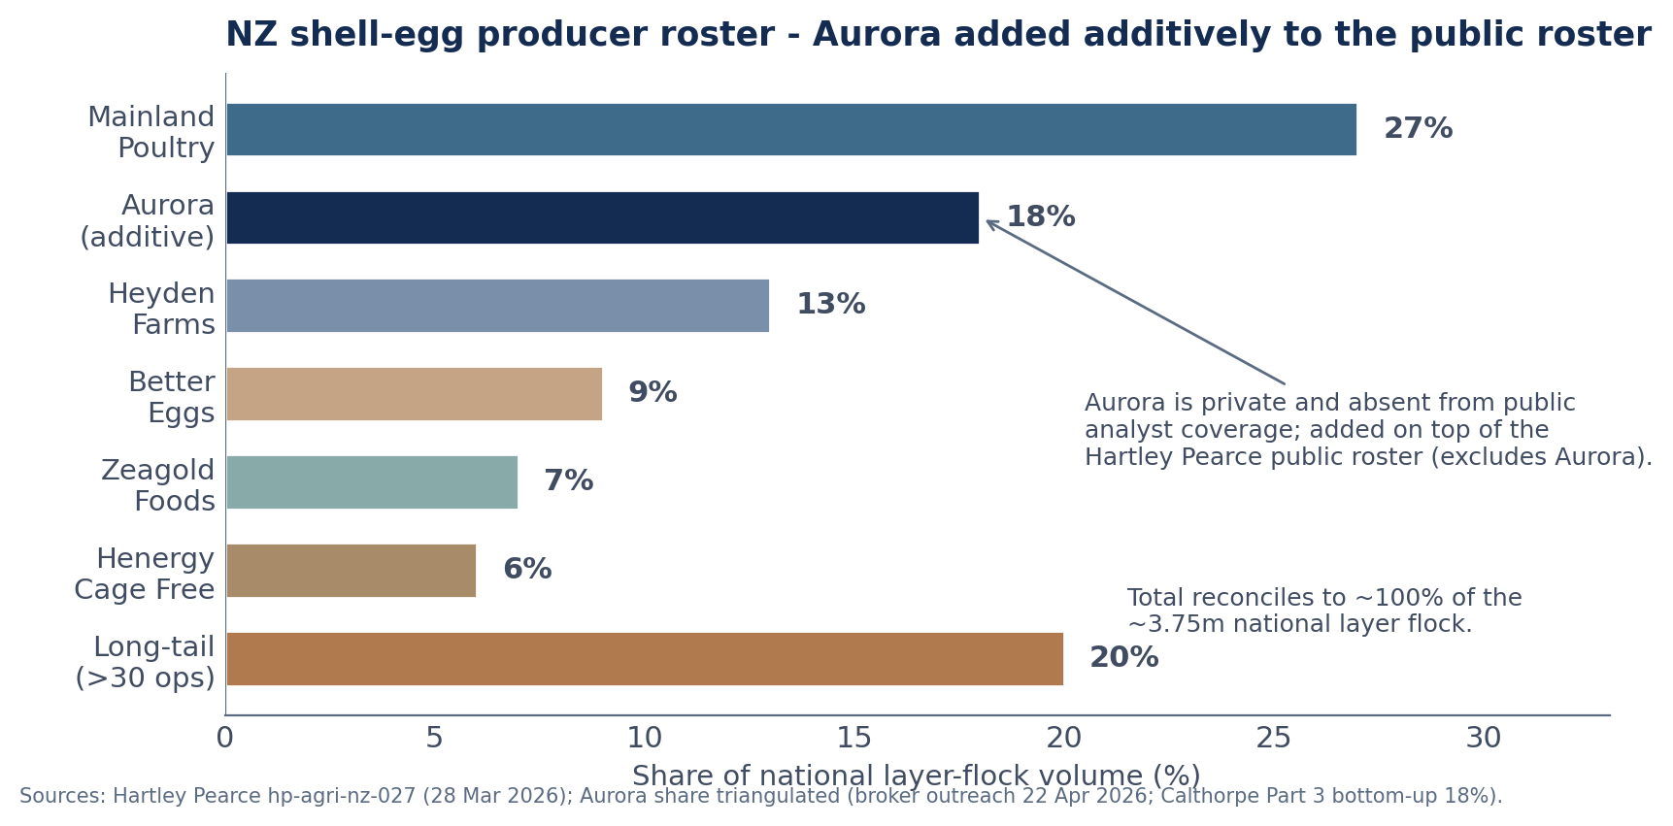
COMPETITIVE POSITION
NZ producer roster: additive positioning & ownership split
READS
▪ Additive. Public roster (Hartley Pearce, excludes Aurora) = Mainland 27 + Heyden 13 + Better Eggs 9 + Zeagold 7 + Henergy 6 + long-tail 20 = 82%. Aurora ~18% added = ~100% of the ~3.75m flock.
▪ Ownership shapes speed. PEP-controlled (Mainland + Zeagold) can move fast on Phase 2 capex; family-with-succession/chair overhang (Heyden, Aurora) will be slower; Better Eggs family-stable; Henergy founder-led.
▪ Strategic flags. Heyden strategic process possibly in the next 12-18 months (South Island, same area as Aurora South). Mainland under PEP will be harder, not softer, on pricing - PEP thesis: “accelerate Phase 2 + broaden adjacencies”.
▪ Implication. Aurora's thesis cannot assume a passive #1 competitor, and its own conversion speed is gated by governance, not just capex.
Project Albatross | Aurora Eggs - Preliminary Target Assessment
Halberd Capital Partners - Internal / Pre-LOI
Strictly private & confidential | 7

Slide 8
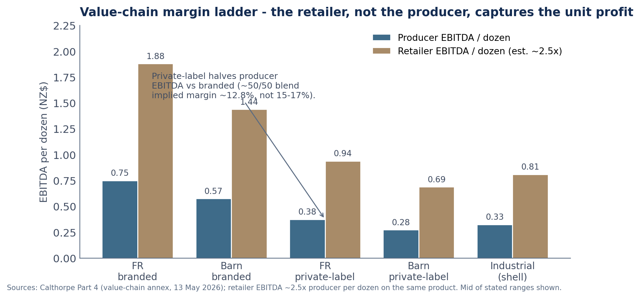
COMPETITIVE POSITION
Value-chain margin ladder: Aurora as price-taker
READS
▪ Retailer captures the unit profit. Retail is structurally the highest-margin step; the producer is asset-heavy, low-margin per dozen, capital-intensive. Retailer EBITDA/dozen runs ~2.5x the producer's on the same product.
▪ Private-label halves producer margin. Aurora is ~50% blended PL; PL gate is 12-18% below branded and PL halves producer EBITDA/dozen. Reported 12.8% margin fits a 50/50 blend; a pure-branded model (15-17%) overshoots achievable margin.
▪ No category-captaincy. Mainland holds captaincy at both retailers (planogram influence, ~1-2pp share-of-shelf). Aurora lives with Mainland's planogram.
▪ Price-taker, not price-setter. “#2 at 18% vs #1 at 27% means Mainland sets the price and Aurora follows... half their retail is PL where they have no pricing power by definition.” The sell-side “price-setter” framing is not supported.
Source: Calthorpe Part 4 (value-chain annex, 13 May 2026).
Project Albatross | Aurora Eggs - Preliminary Target Assessment
Halberd Capital Partners - Internal / Pre-LOI
Strictly private & confidential | 8

Slide 9
COMPETITIVE POSITION
Vertical integration depth: Mainland full stack vs Aurora mid-stack
MAINLAND POULTRY - full 7-stage stack (cohort benchmark)
AURORA - ~4-stage mid-stack
▪ 1.2m birds / 7 farms / 17 sites / 635 ha (OIO records).
▪ MainFeeds: 3 mills, ~140k tonnes compound feed/yr (captive).
▪ Farmer Brown + Woodland retail brands; category captaincy at both retailers.
▪ Captive rearing; Zeagold automated vision-graded line (2025).
▪ Rearing, lay, grade/pack, distribution - no captive feed mill.
▪ No captive breeder/rearing; no vision-graded automated line.
▪ Thinner brand portfolio (Sunbright FR + secondary barn/colony label); 2 sites.
▪ ~2.8x smaller revenue; no category-captain status at either retailer.
▪ Structural discount. “Aurora's #2 share by volume sits alongside #4-5 ranking on integration depth... Mainland traded at 7.0-7.5x with the full stack. Aurora without the full stack does not earn a multiple uplift over that comp - it earns a structural discount.”
▪ Margin / mix positioning. Mainland 14-16% EBITDA margin (70/30 brand/PL); Aurora 12.8% (50/50); Henergy highest brand-skew (75/25, pure FR); Zeagold margin holds via egg-products/industrial mix. Aurora is mid-pack to bottom-tier on margin and PL exposure despite the #2 volume rank.
▪ Two-site concentration. Materially thinner than Mainland's 17-site / 3-mill network. Single-site failure (biosecurity, fire, regulatory shutdown) is a step-change higher exposure; dual-island spread is partial protection only (one site per island).
▪ Silver lining. The gap vs Mainland on integration depth and automation is simultaneously the structural discount and the size of the post-acquisition cost-out opportunity (see Opportunities).
Sources: Navis 2017 press release; MainFeeds public materials; Hartley Pearce hp-agri-nz-027; Calthorpe Parts 4 & 6.
Project Albatross | Aurora Eggs - Preliminary Target Assessment
Halberd Capital Partners - Internal / Pre-LOI
Strictly private & confidential | 9

Slide 10
02
Consumer-demand context
What the demand picture supports - and the specific tier it does not. Aurora is positioned at the elastic end of premium.
Internal / Pre-LOI | 10

Slide 11
CONSUMER-DEMAND CONTEXT
Category-level demand tailwinds
▪ Dietary-mix shift. Flexitarian 21.4% of NZ adults (vs 14.3% Wave 7); vegetarian 7.3% (flat); vegan 1.5% (small, fastest-growing in % terms); traditional omnivore 69.8% (compressing). Per-capita eggs: traditional 224, flexitarian 242, vegetarian 263, vegan 0; national weighted 229/adult/yr. Net ~0.4-0.5pp/yr tailwind from segment migration.
▪ Demographic-cuisine compounding. Asian-NZ cohort 268 eggs/yr (+17% vs national); Pasifika 246 (+7.4%). Asian-NZ ~17% of adults today, projected ~22-24% by 2038. Adds ~0.2-0.3pp/yr.
▪ Generational mix. Net positive - Gen Z 245 and Millennials 238 eggs/yr (above national); Gen X / Boomers / Silent below. Generational transition supports category volume.
▪ Protein & cholesterol narrative. “High in protein” driver rank 8th -> 3rd; “heart-healthy / cholesterol-friendly” 11th -> 8th. Heart Foundation NZ softened to “at-risk individuals up to 6 eggs/week” (vs the old “limit three”).
▪ NZ-made provenance shield. “Product of NZ” 5th -> 2nd ranked driver. Table-egg imports are negligible (MPI biosecurity), so provenance accrues at category level and partially shields NZ shell-egg volume from imported plant-based displacement.
▪ Net. Per-capita drift ~+0.6-0.8% pa on top of population ~0.9% pa (Treasury). Category volume is a genuine tailwind - but this is a category-level read, not a free-range-premium-tier read.
Sources: ACII Wave 11 Egg Category Addendum; Calthorpe Part 5 (consumer-demand annex, 19 May 2026); Heart Foundation NZ; NZ Treasury demographics.
Project Albatross | Aurora Eggs - Preliminary Target Assessment
Halberd Capital Partners - Internal / Pre-LOI
Strictly private & confidential | 11

Slide 12
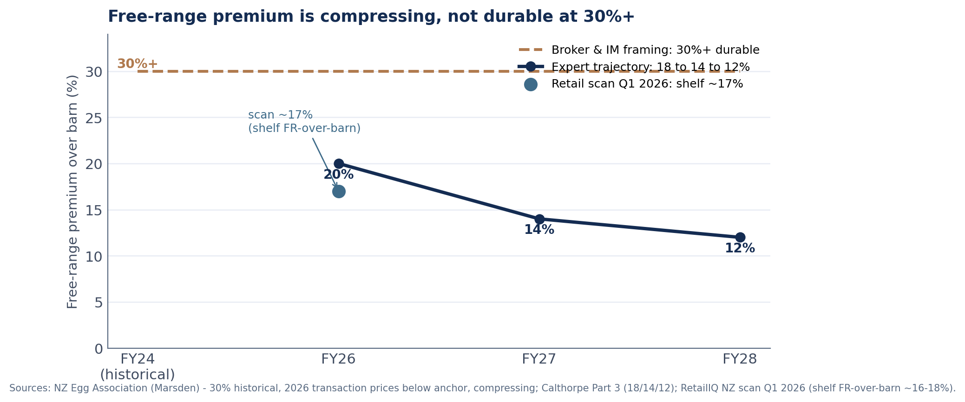
CONSUMER-DEMAND CONTEXT
Free-range premium: broker vs expert vs scan data
READS
▪ Sell-side. Broker & IM: “wholesale FR premium over barn averaged 30%+ over the past decade and expected to remain at or above this level.”
▪ Trade association. Marsden (EPF): historically ~30% at the wholesale gate; 2026 transaction prices are meaningfully below the 30% anchor and likely to keep compressing through Phase 2.
▪ Expert trajectory. Calthorpe Part 3: FY26 18-22% -> FY27 14% -> FY28 12%.
▪ Scan data (Q1 2026). Shelf FR-over-barn ~16-18% (Pak'nSave +15.8%, New World +17.1%, Countdown +17.5%).
▪ Mechanism (supply-side). End-2027 pledges force the ~40% colony cohort to convert; most goes barn (capex NZD 45-65/bird vs NZD 110-150 FR - barn is ~one-third the capex and satisfies the pledge). Barn scales into the colony-exit gap on a 12-24 mo lag; FR loses its scarcity premium.
▪ Finding. Weight the expert / scan-data trajectory over the broker bull. “30%+ durable” is, per the trade association and expert, wrong as stated.
Project Albatross | Aurora Eggs - Preliminary Target Assessment
Halberd Capital Partners - Internal / Pre-LOI
Strictly private & confidential | 12

Slide 13
CONSUMER-DEMAND CONTEXT
Substitution, trade-down & Aurora's demand-side exposure
▪ Plant-based egg substitutes. <1% of NZ shell-egg-equivalent volume today (Orgran, just Egg, OGGS). NZ assortment lags Australia ~18-30 months. Inflection signal: when Foodstuffs / Woolworths NZ range a plant-based SKU on the egg shelf. FY28-30 sensitivity: 1.5-2.5% of national volume displaceable, contingent on retailer assortment. NZ-made provenance partially shields.
▪ Cost-of-living trade-down. 65-70% of shoppers state a free-range preference, but revealed preference differs: ~20-25% of FR buyers are price-sensitive flippers under genuine budget pressure. Commodity FR is the elastic / promo-driven tier; specialty premium (pasture-raised, omega-3, organic) is durable (top-2-income skewed, 4-9% switch rates).
▪ Scan-data elasticity (Q1 2026). Own-price: colony -0.42 (inelastic), barn -0.81, FR commodity -1.34 (elastic, loyalty fragile), pasture-raised -0.56 (inelastic). Largest cross-elasticity is barn <-> FR commodity (~0.62-0.71): as barn supply scales, FR-commodity volume bleeds.
▪ Industrial-side overlay. Industrial buyers (Goodman Fielder, George Weston, mayonnaise mfrs) reformulated lines toward less shell-egg / more liquid-egg or aquafaba during the 2024-25 H7N6 price spike - a distinct, long-term substitution risk on the industrial side.
AURORA EXPOSURE
Long the elastic end, short the durable end
▪ ~50%+ of Aurora's free-range pack is commodity FR - the cost-of-living-elastic, promo-driven tier.
▪ No meaningful pasture-raised, no omega-3, no certified-organic SKU at last check.
▪ Aurora is therefore long the consumer-elastic end of premium and short the consumer-durable end.
▪ Post-acquisition uplift opportunity: premium-tier extension (pasture-raised / omega-3). Confirmatory should validate the absence and quantify launch capex / timing.
Sources: ACII Wave 11 Egg Addendum; Calthorpe Part 5; RetailIQ NZ scan Q1 2026 (elasticity).
Project Albatross | Aurora Eggs - Preliminary Target Assessment
Halberd Capital Partners - Internal / Pre-LOI
Strictly private & confidential | 13

Slide 14
COMPARABLE BENCHMARKING
Comp set construction, multiples & required adjustments
Comparable | Type | Implied multiple | Scale vs Aurora | Adjustment required
PEP -> Mainland Poultry (Jan 2025) | In-NZ control, platform | 7.0-7.5x | ~2.8x rev. | Most direct anchor; vintage 2025; Mainland has the full stack (Aurora lacks it -> structural discount)
Navis -> Mainland / Zeagold (Jul 2017) | In-NZ control, platform | ~6.5x | ~2.8x rev. | Prior-cycle; ~9-yr vintage (pre-Phase-2 pledge); needs vintage adjustment
Better Eggs / Smith family (Aug 2023) | In-NZ tuck-in | 5-6x | <1x (sub-scale) | Sub-scale tuck-in anchor; private discount embedded
Cal-Maine Foods (NYSE: CALM) | Cross-trade, listed pure-play | 9-11x mid-cycle | ~40-80x rev. (FY25 USD 4.13bn) | Scale haircut 35-45% (>10x rev. threshold); multiple itself is HPAI-cycle-inflated
Inghams Group (ASX: ING) | Cross-trade, adjacency | 8-9x | large | Product-mix adjustment: broiler != layer; use for AU/NZ input / labor cost benchmarking, not a valuation multiple
Broker asking (IM / outreach) | Sell-side | 12-14x | n/a | Above the in-NZ precedent band; the spread is the negotiation gap
Comp-set note. Build bottom-up from in-NZ shell-egg control transactions (PEP-Mainland 7.0-7.5x platform anchor, Navis-Mainland 6.5x prior-cycle, Better Eggs / Smith 5-6x sub-scale), with Cal-Maine 9-11x and Inghams 8-9x as cross-trade scale-haircut comps. A top-down build from Cal-Maine 9-11x without the scale haircut, and without engaging PEP-Mainland 7.0-7.5x, has not done the comp work. Vital Farms was considered and dropped - premium-tier mismatch (Aurora is mid-tier FR, not pasture-raised).
Sources: Hartley Pearce hp-agri-nz-027; Navis 2017 press release; Cal-Maine 10-K FY25 (net sales USD 4.13bn); Calthorpe Part 6; Halberd pipeline tracker (Vital Farms dropped).
Project Albatross | Aurora Eggs - Preliminary Target Assessment
Halberd Capital Partners - Internal / Pre-LOI
Strictly private & confidential | 14

Slide 15
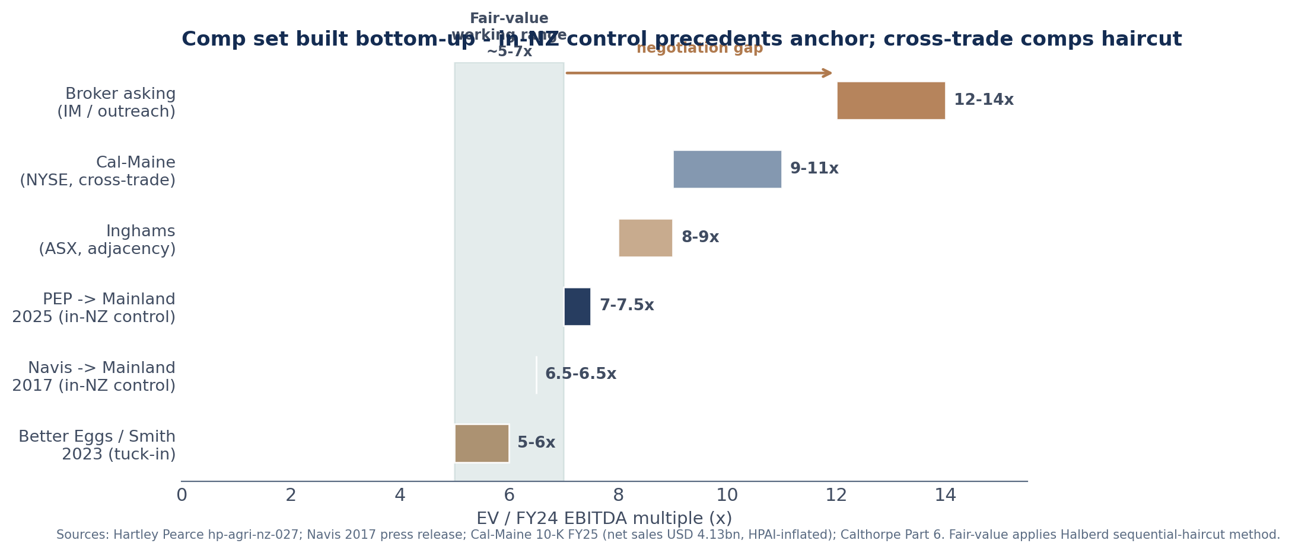
COMPARABLE BENCHMARKING
Valuation haircut logic & fair-value range vs broker asking
METHOD (Halberd analytical standards v3.8)
▪ Sequential haircut. Start from the median public comp; apply scale haircut (35-45% for comps >10x target revenue), then private-company discount (20-25%), then a risk-specific haircut (1.0-1.5x EBITDA absolute for named structural risks).
▪ Worked chain on Cal-Maine. 11.0x -> scale 40% -> 6.6x -> private 22.5% -> 5.1x -> colony-deadline + customer-concentration -0.5 to -1.0x -> 4.1-4.6x. Bottom 9.0x -> ~3.2-3.7x. Top-down Cal-Maine anchors ~3-5x.
▪ More-direct anchor. PEP-Mainland 7.0-7.5x is already a private NZ platform deal (private discount embedded). Apply Aurora's structural discount (no full stack, sub-scale, colony deadline, ~50% PL, customer concentration) -> fair-value working range ~5-7x.
▪ EBITDA base. Reported NZD 10.8m (12.8%) vs IM “adjusted” NZD 12.6m (14.9%) - a NZD 1.8m normalisation to validate; 14.9% sits near a pure-branded model that overshoots the 50/50 PL blend.
▪ Indicative ranges. ~5-7x on reported NZD 10.8m = NZD 54-76m EV; on adjusted NZD 12.6m = NZD 63-88m. Broker 12-14x = NZD 130-176m (on adjusted). Spread = negotiation item.
▪ Tension to surface. Sector Partner's pre-call anchor was 8-10x; the in-NZ-precedent + structural-discount read comes in below that. EBITDA base and risk-haircut sizing are confirmatory items - framed as a finding and an open question, not a bid.
Project Albatross | Aurora Eggs - Preliminary Target Assessment
Halberd Capital Partners - Internal / Pre-LOI
Strictly private & confidential | 15

Slide 16
04
Input-side cost & risk exposures
The cost structure that bears on earnings durability. Aurora is structurally one tier below Mainland on five of eight input categories.
Internal / Pre-LOI | 16

Slide 17
INPUT-SIDE COST & RISK
Input-cost scorecard: Aurora vs Mainland across 8 categories
Input category | Aurora position | vs Mainland | Earnings-durability read
1 Feed grain | Commercial purchase; 4-6 wk inventory; 4-6 mo pass-through lag; no hedge | One tier down (MainFeeds captive; 8-10 wk inventory; physical hedge) | 10% spot spike = 80-110 bps GM hit for 1-2 qtrs
2 Electricity | Standard gentailer tariff; bulk renewed 2024 (pre-spike); expires late 2027 | One tier down (renewal lands as barn load ramps) | +18-22% from FY28 = 150-220 bps margin headwind
3 Day-old chicks / genetics | External: Northern Hylines + spot AU rearers; no captive | One tier down (Mainland captive rearing) | EW Group ~75-80% of global genetics; 2-qtr delay risk recurring
4 Conversion equipment | Big Dutchman signed late 2025; agent channel | Same exposure (all 3 vendors family-European) | 9-14 mo lead; NZD 11-16m vs IM NZD 8-10m
5 Automation leverage | No vision-graded line | One tier down (Zeagold vision line 2025) | Labour 18-22% of variable cost; gap = cost-out lever
6 Packaging (moulded fibre) | Huhtamaki Otahuhu single-supplier | Same exposure (cohort common-mode) | Disruption propagates cohort-wide in 2-3 wks
7 Labour / immigration | 110-130 staff, 2 sites; AEWV wage pressure | Same exposure (same share; Mainland more automation) | Wage pressure through 2026-28
8 ETS / emissions | Currently nil; reversibility risk via 2026 election | Same exposure (cohort) | Re-inclusion = NZD 0.5-1.5m/yr (5-15% of FY24 EBITDA)
Summary. Aurora is structurally one tier down vs Mainland on 5 of 8 categories (feed, electricity, DOC, automation, captive-scale leverage) and carries the same exposure as the rest of the cohort on the other 3. The broker framing “unit economics hold up given scale” is not supported by the input-cost read.
Source: Calthorpe Part 7 (supplier-exposure annex, 3 Jun 2026); USDA FAS; Stats NZ / MBIE; Huhtamaki public site.
Project Albatross | Aurora Eggs - Preliminary Target Assessment
Halberd Capital Partners - Internal / Pre-LOI
Strictly private & confidential | 17

Slide 18
INPUT-SIDE COST & RISK
Feed, electricity, DOC, equipment, packaging, ETS - specifics
▪ Feed. NZD 1.85-2.10/dozen, 55-65% of variable cost. NZ imports ~60% of feed-grain demand (USDA FAS); wheat NZD 430-510/t CY24-25 (spike NZD 540+/t in 2023). No NZX grain futures; ASX wheat does not track NZ landed cost closely enough to hedge. Pass-through lags 4-6 months. Mainland MainFeeds smooths via 8-10 wk inventory + forward AU co-op purchases; Aurora runs 4-6 wk at commercial terms.
▪ Electricity. NZ industrial ~17.8c/kWh (2024); +12% through 2025 (dry-winter / low-hydro); 2026 forward +5%+; ~18-20% cumulative CY24-26. Aurora's bulk contract renewed in 2024 (captured pre-spike for ~3 yrs) - expires late 2027, right as Phase 2 barn load ramps. Carry a +18-22% electricity sensitivity from FY28 (= 150-220 bps margin headwind).
▪ DOC / breeder genetics. EW Group (Hy-Line, Lohmann, H&N) controls ~75-80% of global commercial layer genetics; three companies ~90%. NZ via Northern Hylines (Wellsford) + Henergy Cambridge; Mainland captive. Aurora buys point-of-lay pullets from Northern Hylines + spot AU in dry years. A 2-quarter conversion delay from pullet unavailability is a real, recurring risk.
▪ Conversion equipment. Big Dutchman / Vencomatic / Salmet (family-European). Aurora signed Big Dutchman in late 2025 for the bulk of the conversion (~NZD 11-16m; NZD 45-65/bird across ~240k colony birds). Lead time 9-14 months -> commissioning Q3 2026 to Q1 2027. Tight vs end-2027, no slack.
▪ Packaging. Huhtamaki Otahuhu is the only large-scale NZ moulded-fibre egg-packaging plant (60+ yrs, ~50 FTE). Single-supplier common-mode risk for the whole top-5; Australian moulded-fibre import lead is 4-6 wks, so a disruption propagates cohort-wide in 2-3 wks.
▪ ETS / emissions. Agriculture removed from the ETS in 2024 (He Waka Eke Noa disbanded); currently nil. Hipkins signals the policy is “under review” under Labour; the 2026 election is the trigger. Carry a reversibility scenario: NZD 0.5-1.5m/yr (5-15% of FY24 EBITDA) from FY29.
Sources: Calthorpe Part 7; USDA FAS NZ Grain & Feed; Stats NZ / MBIE electricity; Beehive Jun 2024 ETS release; Huhtamaki public site; NPS Highly Productive Land 2022.
Project Albatross | Aurora Eggs - Preliminary Target Assessment
Halberd Capital Partners - Internal / Pre-LOI
Strictly private & confidential | 18

Slide 19
OPPORTUNITIES - TOP LINE
Top-line opportunities - sized levers
▪ Premium-tier extension. Aurora is currently absent from pasture-raised, omega-3 and certified-organic SKUs (website flags a small pasture-raised line “coming 2027”). Specialty premium is the durable, inelastic tier (scan elasticity -0.56; 4-9% switch rates). Sized: incremental EBITDA ~NZD 0.5-1.5m/yr at maturity, contingent on launch capex / timing (to validate).
▪ Capture share from the exiting colony cohort. Phase 2 per-bird capex NZD 45-65 sets up a rationalisation window; 6-10 long-tail operators expected to exit by FY28. An institutionally-funded Aurora owner could capture displaced volume. Sized: +2-3pp incremental share over the period (broker / IM thesis) - but contingent on Aurora's own conversion executing; at risk if its conversion slips.
▪ Specialty & long-tail roll-up (inorganic). 5-8 named specialty operators (~150-200k birds combined; ~NZD 3-8m each at 5-6x; ~NZD 30-50m to roll up the specialty book) plus 3-5 long-tail commercial tuck-ins at 4-5x. Procurement synergies 4-6% of combined opex; footprint 5-12%; commercial 3-5%; G&A 40-60% of acquired. Near-term tuck-ins 1-2 yrs post-close; integration risk and management bandwidth required.
▪ Channel expansion. Aurora is retail-heavy (70%); foodservice / industrial under-indexed vs a balanced platform. Foodservice gate is ~10-15% below retail wholesale but carries lower promo / trade-spend intensity. Sized: modest, incremental EBITDA ~NZD 0.3-0.8m/yr from targeted foodservice growth (to validate).
▪ Category volume tailwind (baseline). +0.6-0.8% pa per-capita plus ~0.9% pa population = ~1.5-1.7% pa category volume - supports flat-to-modest organic growth. This is well below the IM's 5-7% pa revenue projection, which assumes 1.5-2.0% pa per-capita plus 2-3pp share capture.
Sources: Calthorpe Parts 5-6; Hartley Pearce hp-agri-nz-027; RetailIQ NZ scan Q1 2026; Halberd analytical standards 4.1 / 4.3. Each lever sized per 4.1; ranges are interview / scan-data-anchored and need confirmatory validation.
Project Albatross | Aurora Eggs - Preliminary Target Assessment
Halberd Capital Partners - Internal / Pre-LOI
Strictly private & confidential | 19

Slide 20
OPPORTUNITIES - BOTTOM LINE
Bottom-line opportunities & by-product economics
▪ Automation / labour productivity. The Mainland gap is the opportunity. Zeagold commissioned NZ's first vision-graded automated line (2025); Aurora has not. Labour is 18-22% of variable cost across 110-130 staff / 2 sites. Sized: automation + scale-on-supplier-negotiation cost-out ~NZD 1.0-2.0m/yr EBITDA at maturity; capex ~NZD 3-6m; payback ~3-4 yrs (to validate).
▪ Procurement / vertical integration. Feed is 55-65% of variable cost; Aurora has no captive mill. Options: co-op feed purchasing, forward contracts, partial integration at platform scale. Sized: feed-cost smoothing ~40-80 bps GM in shock quarters; full integration is a platform-level (not single-asset) play.
▪ Trade-spend discipline. Branded trade-spend is 4-7% of retail revenue (slotting, end-caps, multi-buy rebates) - netted into gate but not always broken out. Scan data: commodity FR on promo 54-69% of weeks at 18-22% depth. Cutting promo frequency toward ~35-40% of weeks could capture 1-2pp price realisation without proportional volume loss (FR elasticity -1.34; validate). Sized: ~NZD 0.5-1.0m/yr.
▪ Working capital. Retail terms 60-90 days (Foodstuffs 60, Woolworths NZ 60-90) vs feed suppliers at 30 days -> ~30 days of retail revenue tied up (~NZD 5m at ~NZD 60m retail). DSO / DPO discipline is a modest one-time release.
▪ Manure offtake revenue offset (commonly missed). Ravensdown / Ballance buy NZ layer-farm manure as a Class A organic input at NZD 15-25/t. Aurora's 610k flock implies ~18,000-22,000 t/yr and ~NZD 300-500k/yr revenue offset (Calder benchmark ~NZD 280k peak for a ~600k-bird op). Real, sized, and under-weighted in sell-side shell-egg framing.
▪ Spent-hen disposal - not a revenue lever. Closer to a cost than a revenue line (low-margin rendering / pet-food channel). A sell-side deck treating spent-hens as hidden value needs the offtake contract, not the research note.
Sources: Calthorpe Parts 4 & 7; Calder operator; RetailIQ NZ scan Q1 2026; Halberd analytical standards 4.2 & 8.
Project Albatross | Aurora Eggs - Preliminary Target Assessment
Halberd Capital Partners - Internal / Pre-LOI
Strictly private & confidential | 20

Slide 21
BY-PRODUCT & OPTIONALITY
Alternative-use optionality: open question, not an opportunity
SELL-SIDE FRAMING (Tasman Mercantile, 28 May 2026)
INDEPENDENT READ (Calthorpe Part 8 + Calder)
▪ Both Aurora sites carry “meaningful alternative-use optionality beyond the egg business” (Canterbury examined for data-centre and utility-scale solar; Waikato for adjacent agri conversion).
▪ Framed as “a non-trivial underpin on headline transaction value irrespective of the shell-egg outlook”.
▪ Directly contradicts realizability. Both sites sit on rural-production-zoned land on HPL-overlay soils (NPS Highly Productive Land, Oct 2022).
▪ Neither site is in the north-west Auckland data-centre cluster. Consenting for any non-rural use: 24-36 months scoping-to-determination, plus submitter and Environment Court appeal rights.
▪ Realistic optionality. Neighbour amalgamation at rural-production going-concern - “that's the floor and that's roughly the ceiling.” A buyer absorbing the consenting pathway pays for option value, not realised value; expected value is negative once consenting cost and time are factored in.
▪ Treatment in this assessment. Alternative-use optionality is carried as an open question for confirmatory diligence - is there a specific named non-egg buyer prepared to bid on either site at a premium to rural-production going-concern, and at what consenting risk? - not as a bottom-line opportunity and not as a headline-valuation underpin.
▪ Until a buyer is named. It is a sell-side talking point. The deck does not carry an alternative-use optionality premium on Aurora's headline valuation.
Sources: Tasman Mercantile follow-up email (N. Chen to V. Holst, 28 May 2026); Calthorpe Part 8; Calder operator; NPS Highly Productive Land 2022.
Project Albatross | Aurora Eggs - Preliminary Target Assessment
Halberd Capital Partners - Internal / Pre-LOI
Strictly private & confidential | 21

Slide 22
RISKS
Prioritised risk register - top five
Risk | Probability (rationale) | NZD EBITDA at risk (sourced) | Mitigant
1 Colony-to-barn conversion & end-2027 timeline | Medium-High (IM “clear path”; expert 24-30 mo end-to-end, 12-18 mo build, DOC 2-qtr delay risk, equipment 9-14 mo; “no slack”) | Colony ~40% of flock (~240k birds). Retailer delisting of unconverted colony by end-2027 = up to ~NZD 30-34m revenue, ~NZD 2-4m/yr EBITDA at risk. Capex shortfall IM NZD 8-10m vs expert NZD 11-16m = NZD 3-6m to fund. | Confirm consent lodgement dates; secure DOC supply (Northern Hylines) w/ lead-time penalties; phase equipment tranches; negotiate retailer shelf-bridge waivers; stage capex & funding
2 Customer concentration (top-3 retailers ~70% of revenue) | High (structural NZ grocery duopoly; insider read top-3 ~70%; Woolworths single-counterparty delists nationally on one decision) | Loss of one Pams FR PL tender = NZD 8-12m revenue cliff; two PL lines re-tender inside 24 months; full Woolworths loss (35-40% of retail) existential. | Audited top-10 in confirmatory (Sector Partner #1 priority); multi-year supply agreements (Foodstuffs to 2030); diversify into foodservice/industrial; protect PL tenders
3 Free-range premium compression | High (trade association + expert + scan-data all below 30% historical; supply-side barn scaling into the colony-exit gap) | ~30% FR mix, ~50%+ commodity (elastic) FR; trajectory 18->12 = ~6pp; ~NZD 1.5-2m/yr EBITDA headwind on the FR book by FY28. | Shift mix to durable specialty premium (pasture-raised/omega-3, currently absent); lean on barn (lower capex, satisfies pledge); promo discipline on commodity FR
4 Input-cost step-up & pass-through lag (feed, electricity, DOC, packaging, ETS) | Medium-High (Aurora one tier down vs Mainland on 5/8; electricity tariff expires late 2027 as barn load ramps; ETS reversibility via 2026 election) | 10% grain spike = 80-110 bps GM for 1-2 qtrs; electricity +18-22% from FY28 = 150-220 bps; ETS re-inclusion NZD 0.5-1.5m/yr (5-15% of FY24 EBITDA); combined ~NZD 1.5-3m/yr by FY28-29 if pass-through lags. | Forward feed procurement / co-op purchasing; lock electricity post-renewal; DOC supply security; secondary packaging sourcing; carry ETS reversibility scenario
5 Governance / chair-succession overhang | Medium (broker “stable/unified”; expert contradicts on governance; chair veto on debt/capex/transactions; FY26 NED refresh + likely chair transition coincide) | Indirect - deal-certainty & decision-rights risk; a capex-pacing dispute could delay conversion (links to Risk 1); hard to $-size; flag as a structure / representation risk. | Map board seats / veto rights / succession plan; secure Mark MD retention & operating decision rights; align on capex pacing & the South Island site pre-LOI; board representation for the new capital partner
Note. Biosecurity (H7N6 Otago 2024, stamped out; NZ HPAI-free mid-2025) and single-site / geographic concentration are secondary risks folded into the operational read and held out of the top five to avoid dilution (analytical standards 5).
Project Albatross | Aurora Eggs - Preliminary Target Assessment
Halberd Capital Partners - Internal / Pre-LOI
Strictly private & confidential | 22

Slide 23
KEY FINDINGS SYNTHESIS
Five findings - direction, what we believe, what we don't yet know
# / Direction | What we believe | What we don't yet know
1 Negative Competitive position trails the share rank | #2 by volume (~18%) but #4-5 by integration depth, most PL-exposed mix in the top-5 (ex-industrial), middle-of-pack margin (12.8%), no category captaincy - a price-taker. The broker “cleaner operator / pricing power” framing is a selective view of the volume-share dimension only. | Audited margin bridge; current private-label tender pipeline.
2 Negative Free-range premium compressing | Scan Q1 2026 shelf ~17%; trade-association and expert put the gate premium below the 30% historical anchor, trajectory 18 -> 14 -> 12% FY26-28. Aurora is long the elastic commodity-FR end, short the durable specialty end. “30%+ continuing” is stale. | Aurora's specific FR contract pricing vs shelf.
3 Negative / contested Colony-to-barn bridge is tight | IM capex NZD 8-10m understates the NZD 11-16m expert sizing; build 12-18 mo once consents in hand; equipment 9-14 mo; DOC 2-qtr delay risk; consenting 24-36 mo end-to-end. “Clear path by 2027” is optimistic; “manageable but no slack.” | Whether consents are lodged; DOC supply-contract status.
4 Negative Input-cost position one tier below Mainland | Structurally one tier down on 5 of 8 categories, with a 2027-28 electricity step-up coinciding with the barn-load ramp and ETS reversibility risk via the 2026 election. “Unit economics hold up given scale” is not supported. | Current electricity tariff & renewal terms; feed procurement terms.
5 Positive Real bottom-line & roll-up levers | Category demand is a genuine tailwind; there are real post-acquisition levers - automation / scale cost-out vs Mainland, premium-tier extension (pasture-raised / omega-3, currently absent), specialty & long-tail roll-up, and a commonly-missed NZD 300-500k/yr manure offset. Alt-use land-bank optionality is small and an open question, not a value lever. Value-creation sits on the bottom-line and roll-up, not on top-line premium durability. | Sized synergy capture; roll-up candidate availability / pricing; a named non-egg land buyer.
Project Albatross | Aurora Eggs - Preliminary Target Assessment
Halberd Capital Partners - Internal / Pre-LOI
Strictly private & confidential | 23

Slide 24
OPEN QUESTIONS
Open questions for confirmatory diligence
▪ Customer concentration. Audited top-10 customer revenue (Sector Partner #1 priority); private-label tender calendar, win/loss history, and re-tender dates for the two lines inside 24 months.
▪ EBITDA quality. FY24 reported NZD 10.8m (12.8%) vs IM “adjusted” NZD 12.6m (14.9%) - the NZD 1.8m normalisation schedule; trade-spend roll-up; working-capital terms.
▪ Conversion execution. Consent lodgement status & dates; build start; equipment tranche schedule (Big Dutchman); DOC supply contract (Northern Hylines) with lead-time guarantees; capex realism NZD 8-10m vs NZD 11-16m and the funding plan.
▪ Pricing evidence. Current transaction-price (gate, not shelf) evidence for FR vs barn vs colony; producer-by-producer volume-share triangulation (confirm Aurora ~18% additive).
▪ Governance. Chair-succession plan; board seats, veto rights, FY26 NED refresh; Mark MD retention & operating decision rights; family alignment on capex pacing & the South Island site.
▪ Input costs. Electricity tariff level & renewal date; feed procurement terms & inventory policy; secondary packaging sourcing; ETS policy outlook.
▪ Optionality. Is there a named non-egg buyer for either site at a premium to rural-production going-concern, and at what consenting risk?
▪ Operating. Automation roadmap vs Mainland's Zeagold vision-graded line; single-site-failure / biosecurity continuity plan; H7N6-insurance premium step (reportedly +25-35% on renewal).
These open questions define the confirmatory-DD work plan. No recommendation is made at this pre-LOI stage; the IC decides whether to advance.
Project Albatross | Aurora Eggs - Preliminary Target Assessment
Halberd Capital Partners - Internal / Pre-LOI
Strictly private & confidential | 24

Slide 25
APPENDIX
Sources, methodology & caveats
▪ Primary deal materials. Anchor Bay IM draft v0.4 (28 Feb 2026); Tasman Mercantile outreach (N. Chen, 20 & 22 Apr 2026; land-bank note 28 May 2026); Aurora website snapshot; Halberd internal screening brief (V. Holst, 4 May 2026); deal pipeline tracker.
▪ Industry / market. Hartley Pearce hp-agri-nz-027 (28 Mar 2026); RetailIQ NZ scan Q1 2026; MPI Layer Hens Code of Welfare; USDA FAS NZ Grain & Feed; Stats NZ / MBIE electricity; Beehive 2024 ETS release; NPS Highly Productive Land 2022.
▪ Expert transcripts. Calthorpe Parts 1-8 (industry expert); Calder (operator); Marsden (NZ Egg Producers Federation); foodservice broker; retired consultant; ex-egg farmer.
▪ Comparables & standards. Cal-Maine 10-K FY25; Inghams Group (ASX); Navis 2017 press release; PEP -> Mainland 2025; Halberd IC pre-read template, analytical standards v3.8, brand guidelines 2026, central financial assumptions (FX, WACC NZ 10.5%, inflation).
▪ Method. Preliminary outside-in CDD; triangulation across sell-side, independent expert, trade association and scan data; private target treated additively; comp valuation uses the sequential-haircut method; findings, risks and open questions only - no recommendation.
▪ Caveats. Privately-held figures are triangulated (Calthorpe / Hartley Pearce) with ~10-15% uncertainty; Aurora does not appear by name in public reports or retailer scan data; the MPI 33/33/34 mix is 2022 vintage; NZD as stated, USD via FY24 NZD 0.602.
▪ Excluded. Intern pack (J. Park) - multiple errors contradicted by primary sources: revenue NZD 120m vs 84.6m; “largest producer” vs #2; “no cage exposure” vs 40% colony; “Inghams mostly eggs” vs broiler; Vital Farms as comp. Reviewed and dropped; not used.
▪ Note on framing. Where the sell-side and independent reads diverge (free-range premium, conversion timeline, governance, input-cost competitiveness, land-bank optionality) both are surfaced and the divergence named, per Halberd analytical standards.
Project Albatross | Aurora Eggs - Preliminary Target Assessment
Halberd Capital Partners - Internal / Pre-LOI
Strictly private & confidential | 25

